Slide 1
Switching
Gihan Dias
CS2032
2011S3 – Aug 2013

Slide 2
Outline
Types of Network
Switching
Circuit Switching
Message Switching
Packet Switching
  Virtual circuit switching
  Datagram switching
  Label Switching

Slide 3
Types of Network
Unswitched
  Point-to-point
  Multi-point
  Broadcast
Switched

Slide 4
Why Switched Networks?
3 nodes
3 links
4 nodes
6 links
5 nodes
10 links
10 nodes - ? links

Slide 5
Why Switched Networks?
Not cost effective to have all nodes DIRECTLY connected to all other nodes
Unlike LANS, the nodes could be spread out and vast in number (can’t broadcast the signal)
The signal can be switched from sender to receiver

Slide 6
Switching: abstract model
input
output
Number of connections: from few (4 or 8) to huge (100K)

Slide 7
Why switching?
To get signals to the correct destination
Needed when source and destination are not directly connected
  e.g. travelling by bus
Used when network is large in size or number of stations

Slide 8
Routing and Switching
Routing
  Identifies the route traversed by data to get from source to destination
Switching
  Transfers data from one network / link to another

Slide 9
Types of switching
Circuit switching
Message switching
Packet switching
  Virtual circuit
  Datagram

Slide 10
Circuit Switching
A dedicated communications path is pre-allocated
This requires the caller, callee and all intervening links and nodes to be available at the same time
Once established, circuit capacity must be paid for, whether or not it is used

Slide 11
Circuit Switching
The route, once it is set up,
  has low transmission delays (good)‏
  cannot be optimised (bad)‏
Suits human-to-human telephone communications
Less suitable for computer communications
  Set up time
  Cannot handle data bursts

Slide 12
Types of Circuit Switching
Space-division switching
  Each call takes a different path through the switch
Time-division switching
  Each call is divided into small pieces and each piece is assigned a time-slot
  The contents of each time-slot are switched independently

Slide 13
Space Division Switch

Slide 14
Space division switching
Each sample takes a different path through the switch, depending on its destination
Crossbar: Simple space-division switch
Crosspoints can be turned on or off
i
n
p
u
t
s
outputs

Slide 15
Crossbar - example
sessions: (1,2) (2,4) (3,1) (4,3)
inputs
1
2
3
4
1
2
3
4
output

Slide 16
Time-Division Switching
Multiplexor: aggregates sessions
  N input lines
  Output runs N times as fast as input
Demultiplexor: distributes sessions
  one input line and N outputs that run N times slower
Can cascade multiplexors
1
2
N
De-Mux
1
2
N
Mux
1 2 N

Slide 17
Time Slot Interchange (TSI) : example
sessions: (1,3) (2,1) (3,4) (4,2)
1
1
2
3
4
2
2
1 2 3 4
4
3 1 4 2
3 1 4 2
3
1
4
3
write to shared memory and read in different order

Slide 18
Problems with Circuit Switching
Efficiency
  The circuit may be idle much of the time
  especially in computer communications
Delay
  time needed to set up the circuit
  but low delay once circuit is set up

Slide 19
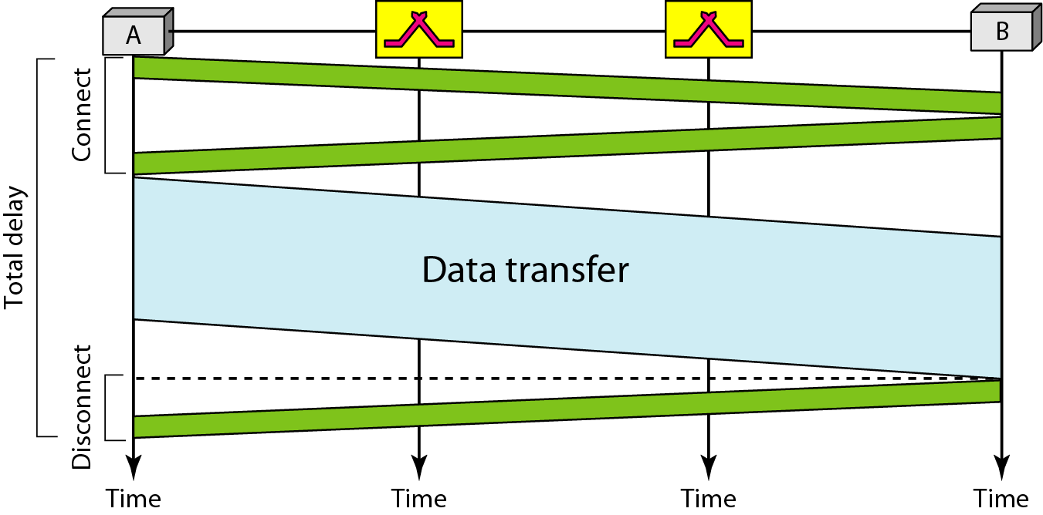
Delays in Circuit-Switch Network

Slide 20
Message Switching
Entire messages sent store-and-forward, hop-by-hop
Message makes intermittent progress as each hop becomes available
End-to-end delivery time cannot be guaranteed
Very long messages can:
  hog buffer space at intermediate nodes
  hog the links between them

Slide 21
Packet Switching
Network comprises a set of nodes (switches or routers)‏
  intermediate stations
Connected by links
  point to point
  broadcast
D
Broadcast
NW
E
router
B
F
H1
A
G
H2
host
Pt-Pt
link
C

Slide 22
Packet Switching (cont.)‏
Data stream is divided into packets
Each packet comprises data and a header
100100011100101000011110101101011110001
Data Stream
101101
100100011100101
Packet 1
Header Data
101100
00001111010110
Packet 2
Header Data
Packet 3
101111
1011110001
Header Data

Slide 23
Packet Switching (cont.)‏
Data sent from one host to another
  end stations
Each intermediate station switches each incoming packet through a link to another node
Packets make their way through the network from node to node and finally to their destination

Slide 24
Packet Switching
router
D
B
packet
H1
A
E
H2
host
C

Slide 25
Types of Packet Switching
Virtual Circuit Switching
Datagram Switching
Label Switching

Slide 26
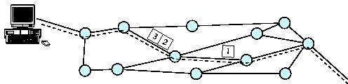
Virtual Circuit Packet Switching
Connection set up between end stations before data is transferred
the packets are sent along a pre-chosen route
Set-up delay before sending data

Slide 27
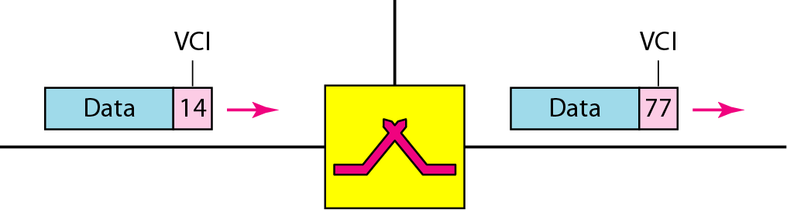
Virtual-Circuit Identifier
Each packet is assigned to a virtual circuit
Each VC has a Virtual Circuit Identifier
Different VCIs on each link
Dr. J M Garrido
Fall 2009

Slide 28
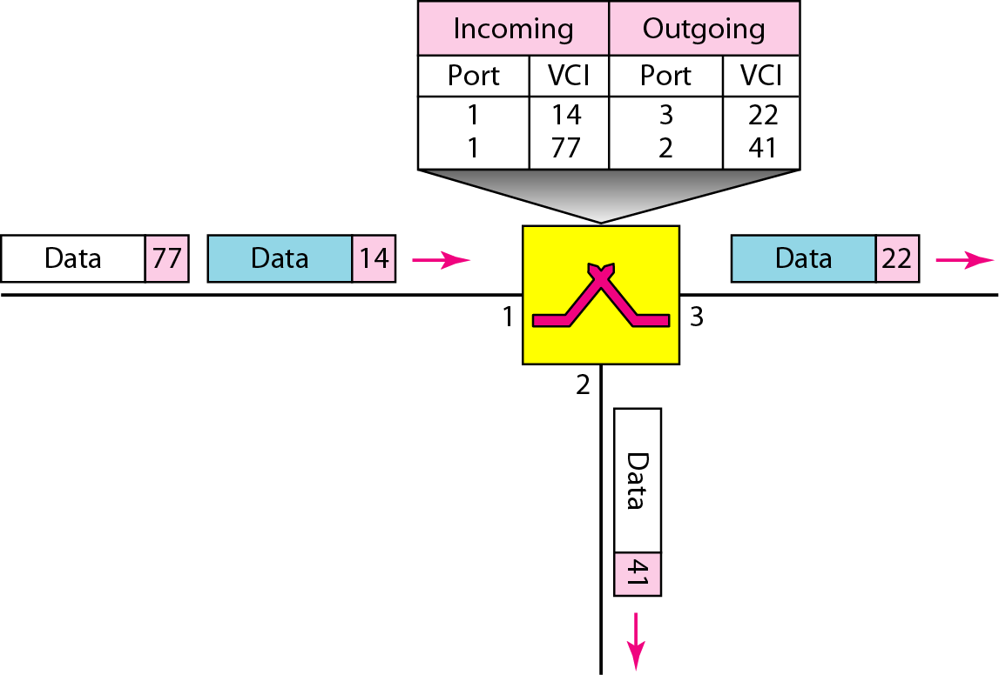
Dr. J M Garrido
Fall 2009

Slide 29
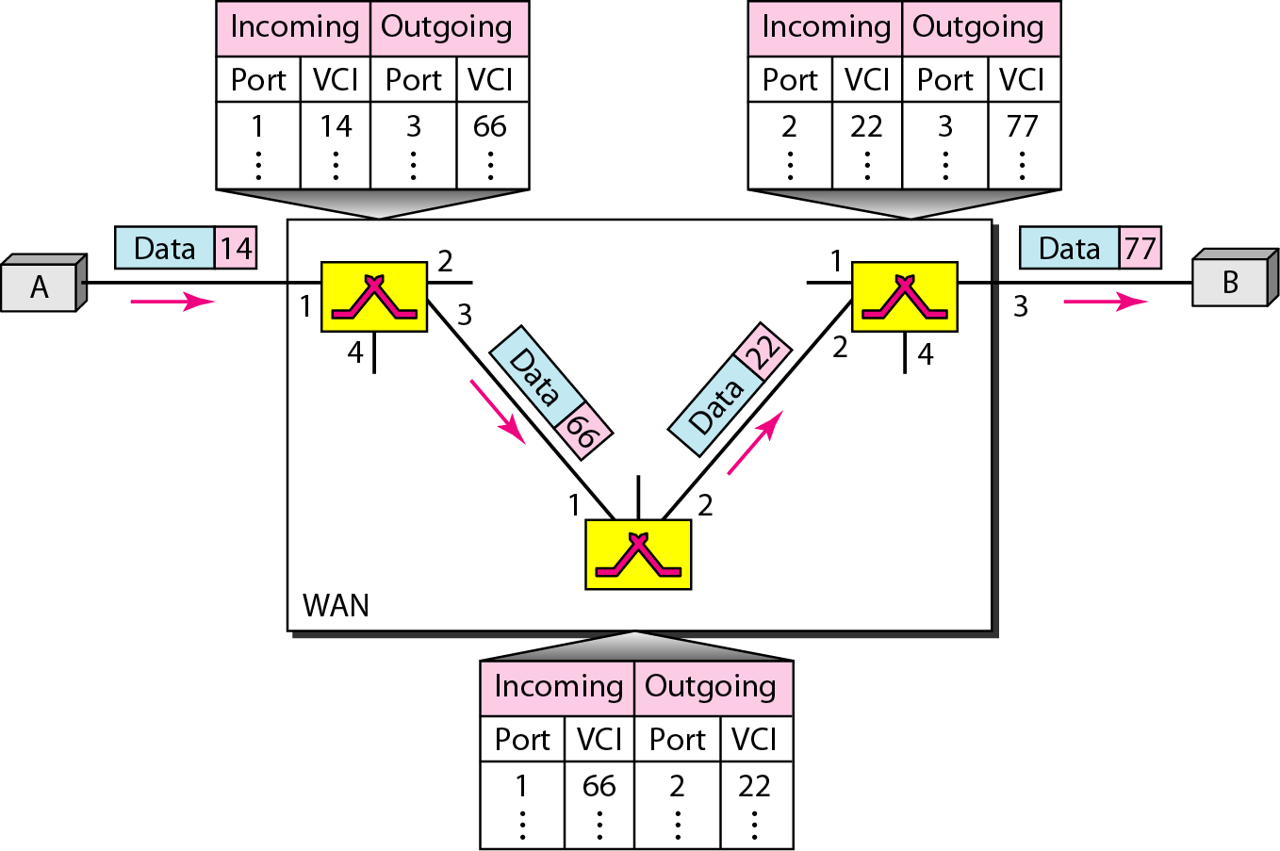

Slide 30
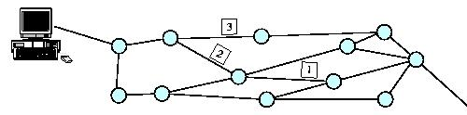
Datagram Packet Switching
Packets are routed independently
No initial circuit set-up costs or delays
Switching each packet is relatively expensive
adapts to node and link failures during transmission
datagrams may arrive out of order

Slide 31
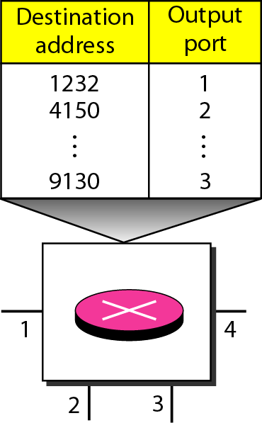
A Datagram Switch
A switch in a datagram network uses a routing table that is based on the destination address.
The destination address in the header of a packet in a datagram network remains the same during the entire journey of the packet.
Dr. J M Garrido
Fall 2009

Slide 32
Label Switching
Route at edges – Switch in core
A Label is attached to each packet when it arrives at a label switched network
Each core switch switches the packet based on the label, and then substitutes a new label for the next hop

Slide 33
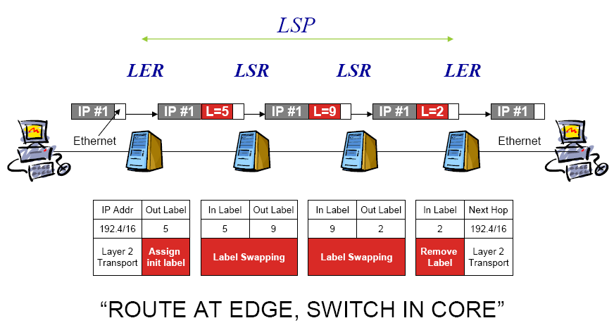
Label Switched Network

Slide 34
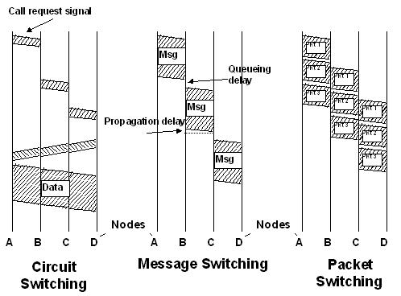
Switching Strategies
message progress under each main strategy:
time:

Slide 35
Summary
Types of Network
Circuit Switching
Message Switching
Packet Switching
  Virtual circuit switching
  Datagram switching
  Label Switching

